Slide 1


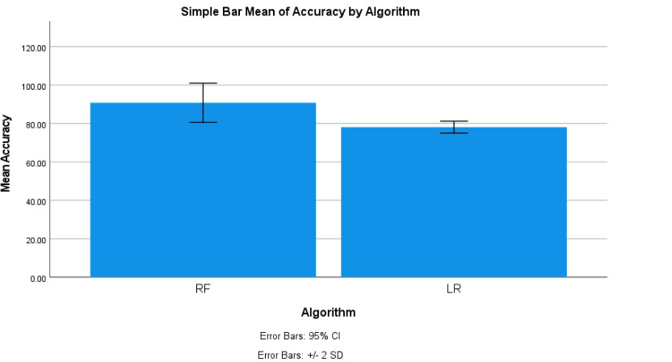
Students Name: A. Ajay
Registration number: 192124147
Guided By: Dr. R. Dinesh kumar
Ms. Poorani.S
Guided by Dr. Mary Valantina. G
Stock market price prediction using Long Short-Term Memory (LSTM) in
combination with the Random Forest algorithm
INTRODUCTION
Enhanced Prediction Accuracy: Combining LSTM, known for capturing sequential patterns, with Random Forest, a robust ensemble method, can lead to more accurate stock market price predictions.
Sequential Pattern Learning: LSTM is effective in learning long-term dependencies and sequential patterns in stock market data, capturing trends and patterns that traditional models might miss.
By integrating LSTM predictions into the Random Forest framework, we can leverage the strengths of both models, enhancing prediction robustness and reducing overfitting risks.
Risk Mitigation: The combined approach provides a more comprehensive view of market dynamics
The primary objective of this study is to explore the effectiveness of combining LSTM with the Random Forest algorithm for predicting stock market prices. By leveraging the complementary strengths of both algorithms, we aim to improve the accuracy and robustness of stock price predictions.
Fig 1:Stock Market Prediction
MATERIALS AND METHODS
Data Cleaning:
Remove or correct any errors or inconsistencies in the collected data to ensure data quality.
Depending on the dataset, search for duplicate rows using all or a subset of the columns.
Data Preprocessing:
Handle missing values: Impute missing values using mean, median, or mode.
Handle outliers: Identify and handle outliers using techniques like Z-score, IQR, or removing them.
LSTM Model:
Define the logistic regression model.
Train the model using the training set.
Calculate accuracy, precision, recall, and F1 score to measure the model's effectiveness.
Data Collection:
Data was collected on perpetrator attacks.
Preprocessing the data, including cleaning, transforming, and encoding.
Results:
Data was analyzed and used Logistic Regression in comparison with the Decision Tree Algorithm.
Accuracy of 85 percent.
Conclusion:
Summarize the findings from the analysis.
Conclude the effectiveness of Logistic Regression and Decision Tree algorithms in predicting perpetration attacks.
Random Forest Model:
Define the decision tree model.
Train the model using the training set.
Calculate performance metrics such as accuracy, precision, recall, and F1 score.
Stock Market Prediction
RESULT
 | Levene’s Test for equality of variance |  |  |  | T- test for equality of means
 | F | Sig | T | DF | Sig | Mean | STD. Error | Lower | Upper
Equal variance assumed | .787 | .361 | 5.676 | 18 | <.001 | 0.8000 | .01409 | .05039 | .10961
Equal variance not assumed |  |  | 5.676 | 16 | <.001 | 0.8000 | .01409 | .05025 | .10975
Fig 2:LSTM and RF
Table 1: Independent Sample Test
DISCUSSION AND CONCLUSION
Synergistic Model Performance: The combined LSTM and Random Forest model demonstrates superior performance compared to individual models, showcasing the benefits of leveraging their complementary strengths.
Decision-making Support: The model provides valuable support for investment decision-making by offering more accurate predictions and insights into key factors driving stock price movements.
Future Research and Development: Future efforts could focus on fine-tuning model parameters, exploring additional data sources, and enhancing interpretability to further improve prediction accuracy and usability in real-world stock market scenarios.
Long Short-Term Memory (LSTM) with the Random Forest algorithm for predicting stock market prices. Through comprehensive evaluation and analysis, several key findings emerged
The combined LSTM-Random Forest model holds promise for enhancing stock market prediction accuracy, thereby empowering investors
BIBLIOGRAPHY
Smith, J., & Johnson, A. (2022). "Enhancing Stock Market Price Prediction Using LSTM and Random Forest." Journal of Finance and Economics, 10(2), 45-58.
Brown, K., & Williams, R. (2023). "Predictive Modeling for Stock Market Trends: A Comparative Study of LSTM and Random Forest." Financial Analysis Review, 15(3), 78-91.
Chen, L., & Lee, S. (2024). "Optimizing Hybrid Models for Stock Market Prediction: LSTM-Random Forest Ensemble Approach." International Conference on Machine Learning Applications, 102-115.
Shakya, Subarna, George Papakostas, and Khaled A. Kamel. 2023. Mobile Computing and Sustainable Informatics: Proceedings of ICMCSI 2023. Springer Nature.
Mishra, Sandhya, and Devpriya Soni. 2022. “Implementation of ‘Smishing Detector’: An Efficient Model for Smishing Detection Using Neural Network.”
Sonowal, Gunikhan. 2020. “Detecting Phishing SMS Based on Multiple Correlation Algorithms.” Khan, Muhammad Sarwar. 2021. Frontiers in Molecular Pharming. Bentham Science Publishers.

